Slide 1



Stepwise Model Tree Induction
prof. Donato Malerba
dott.ssa Annalisa Appice
dott. Michelangelo Ceci
Department of Computer Science
University of Bari
Knowledge Acquisition &
Machine Learning Lab

Slide 2

Regression problem in classical data mining
Given
  m independent (or predictor) variables X_{i} (both continuous and discrete)
  a continuous dependent (or response) variable Y to be predicted
  a set of n training cases (x₁, x₂, …, x_{m}, y)
Learn
  a function y=g(x) such that it correctly predicts the value of the response variable for each m-tuple (x₁, x₂, …, x_{m})

Slide 3
Regression trees and model trees
Partitioning of observations
+
local regression models
regression
➔ or
models trees
Regression trees: approximation by means of a piecewise constant function
Model trees: approximation by means of a piecewise multiple (linear) function
X₁≤0.1
X₁≤0.3
Y=0.5
X₂≤0.1
Y = 3 +1.1X₁
X₂≤2.1
Y = 1.9
Y = 0.9
Y=3X₁+1.1X₂
Y = 0.9

Slide 4

Model trees: state of the art
Statistics
  Ciampi (1991): RECPAM
  Siciliano & Mola (1994)
Data Mining
  Karalic, (1992): RETIS
  Quinlan, (1992): M5
  Wang & Witten, (1997): M5’
  Lubinsky, (1994): TSIR
  Torgo, (1997): HTL
  …
The tree-structure is generated according to a top-down strategy.
Phase 1: partitioning of the training set
X₁ ≤ 3
Phase 2: association of models to the leaves
Y=3+2X₁

Slide 5
Model trees: state of the art
Models in the leaves have only a “local” validity → coefficients of regressors are estimated on the basis of training cases at the specific leaf.
How to define non-local (or “global”) models ?
IDEA: in “global” models the coefficients of some regressors should be estimated on the basis of training cases at an internal node.
Why? Because partitions of the feature space at internal nodes are larger (more training examples)
A different tree-structure is required
Internal nodes can
  either define a further partitioning of the feature space
  or introduce some regression variables in the regression models.

Slide 6

Two types of nodes
Two types of nodes:
Splitting nodes perform a Boolean test.
t
X_{i} ≤ α
continuous variable
discrete variable
X_{i}∈{x_{i1},…,x_{ih}}
t
t_{L}
t_{R}
t_{L}
t_{L}
t_{R}
Y=a+bX_{u}
Y=c+dX_{w}
Y=a+bX_{u}
Y=c+dX_{w}
Regression nodes compute only a straight-line regression. They have only one child.
Y=a+bX_{i}
t
X_{j} ≤ α
t’
n_{L}
n_{R}
t’_{L}
Y=c+dX_{u}
Y=e+fX_{w}
t’_{R}

Slide 7

What is passed down?
Splitting nodes pass down to each child only a subgroup of training cases, without any change on the variables.
Regression nodes pass down to their unique child all training cases. Values of the variables not included in the model are transformed to remove the linear effect of the variable involved in the straight line regression at the node.
Y=a₁+b₁X₁
Y, X₁, X₂
Y’= Y - (a₁+b₁X₁)
Y’=a₃+b₃X’₂
X’₂=X₂ - (a₂+b₂X₁)

Slide 8

A model tree with two types of nodes
0
Leaves are associated with straight-line regression functions
0
Y=a+bX₁
T
Y=a+bX₁
T
1
1
X₃ ≤ α
X₃ ≤ α
2
7
2
7
X₂ ≤ β
Y=i+lX₄
X₂ ≤ β
Y=i+lX₄
The multiple regression model associated to a leaf is the composition of straight-line regression functions found along the path from the root to a leaf
How is it possible?
3
3
4
4
Y=c+dX₃
Y=c+dX₃
X₄ ≤ γ
X₄ ≤ γ
5
6
5
6
Y=g+hX₃
Y=e+fX₂
Y=g+hX₃
Y=e+fX₂
It’s the effect of the transformation of variables passed down from regression nodes!

Slide 9
Building a regression model stepwise: some tricks
Example: build a multiple regression model with two independent variables:
Y=a+bX₁ + cX₂
through a sequence of straight-line regressions
Build: Y = a₁+b₁X₁
Build: X₂ = a₂+b₂X₁
Compute the residuals on X₂: X'₂ = X₂ - (a₂+b₂X₁)
Compute the residuals on Y: Y' = Y - (a₁+b₁X₁)
Regress Y’ on X'₂ alone: Y’ = a₃ + b₃X'₂.
By substituting the equation of X'₂ in the last equation:
Y = a₃ + a₁- a₂b₃ + b₃X₂ –(b₂b₃-b₁)X₁.
it can be proven that:
a=a₃-a₂b₃ + a₁
b=-b₂b₃ +b₁
c=b₃.

Slide 10
The global effect of regression nodes
Y=a+bX_{i}
t
R
Y
R₁
R₂
X_{j}<α
t’
n_{L}
n_{R}
t’_{L}
Y=c+dX_{u}
Y=e+fX_{w}
t’_{R}
α
X_{j}
  Both regression models associated to the leaves include X_{i}.
  The contribution of X_{i} to Y can be different for each leaf, but
  It can be reliably estimated on the whole region R

Slide 11
An example of model tree
This regression node introduces a variable in the regression model at the descendant leaves
0
T
Y=a+bX₁
1
X₃ ≤ α
2
7
The variable X₁ captures a “global” effect in the underlying multiple regression model
X₂ ≤ β
Y=i+lX₄
3
4
Y=c+dX₃
X₄ ≤ γ
5
6
Y=e+fX₂
Y=g+hX₃
The variables X₂, X₃ and X₄ capture a “local” effect
  SMoTI (Stepwise Model Tree Induction)
  Malerba et al., 2004

Slide 12
Advantages of the proposed tree structure
It captures both the “global” and the “local” effects of regression variables
Multiple regression models at the leaves can be efficiently built stepwise
The multiple regression model at a leaf can be easily computed → the heuristic function for the selection of the best (regression/splitting) node should be based on the multiple regression models at the leaves.

Slide 13
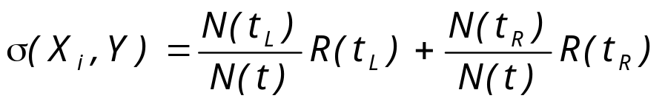
Evaluating splitting and regression nodes
Splitting node:
X_{i} ≤ α
t
t_{L}
Y=a+bX_{u}
Y=c+dX_{v}
t_{R}
R(t_{L}) (R(t_{L}) ) is the resubstitution error associated of the left (right) child.
Y=a+bX_{i}
Regression node:
t
ρ(X_{i},Y) = min { R(t), σ(X_{j},Y) for all possible variables X_{j} }.
X_{j} ≤ α
t’
n_{L}
n_{R}
t’_{L}
Y=c+dX_{u}
Y=e+fX_{v}
t’_{R}

Slide 14
Stopping criteria
Partial F-test to evaluate the contribution of a new independent variable to the model.
The number of cases in each node must be greater than a minimum value.
All continuous variables are used in regression steps and there are no discrete variables.
The error in the current node is below a fraction of the error in the root node.
The coefficient of determination (R²) is greater than a minimum value.

Slide 15
Related works … and problems
In principle, the optimal split should be chosen on the basis of the fit of each regression model to the data.
Problem: in some systems (M5, M5’ and HTL) the heuristic function does not take into account the model associated with the leaves of the tree.
→ The evaluation function is incoherent with respect to the model tree being built.
→ Some simple regression models are not correctly discovered

Slide 16
Related works … and problems
Example:
Cubist splits the data at -0.1 and builds the following models:
X ≤ -0.1: Y = 0.78 + 0.175*X
X > -0.1: Y = 1.143 - 0.281*X
1,8
1,6
1,4
x ≤0.4
1,2
1
0,8
True
False
0,6
0,4
0,2
y=0.963+0.851x
y=1.909-0.868x
0
-1,5
-1
-0,5
0
0,5
1
1,5
2
2,5

Slide 17
Related works … and problems
Retis solves this problem by computing the best multiple regression model at the leaves for each candidate splitting node.
The problem is theoretically solved, but …
  Computationally expensive approach: a multiple regression model for each possible test. The choice of the first split is O(m³N²).
  All continuous variables are involved in multiple linear models associated to the leaves. So, when some of the independent variables are linearly related to each other, several problems may occur (Collinearity).

Slide 18
Related works … and problems
TSIR induces model trees with regression nodes and splitting nodes, but …
The effect of the regressed variable in a regression node is not removed when cases are passed down
the multiple regression model associated to each leaf cannot be correctly interpreted from a statistical viewpoint.

Slide 19
Computational complexity
It can be proven that SMOTI has an O(m³N²) worst case complexity for the selection of any node (splitting or regression).
RETIS has the same complexity for node selection, although RETIS does not select a subset of variables to solve collinearity problems.

Slide 20
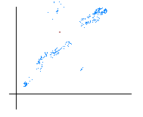

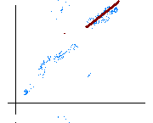
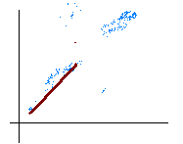
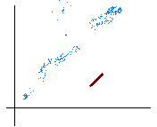
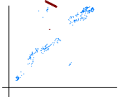

Simplifying model trees: the goal
Problem: SMOTI could fit data well but fails to extract the model
outputs on new data are incorrect
X ≤ α
X ≤ β
X ≤ γ
Possible solution: pruning model tree
  pre-pruning methods control the growth of a model tree during its construction
  post-pruning methods reduce the size of a fully expanded tree by pruning some branches
Notes:
Similar to many decision tree induction algorithms, SMOTI may generate model trees that overfit training data.
For instance if training data contain outliers the discovered regression models distorts its shape to correctly predicts the outliers.
In this case the discovered model is quite different from the model effectively used to generate data so it can fail in predicting the value of the target attribute for new unknown examples
A solution is the pruning that aims to simplify model that overfit the data.
In particular we can use pre-pruning methods that ..
or post pruning methods that …

Slide 21
Pruning of model trees with regression and splitting nodes
Reduced Error Pruning – REP
  pruning operator π_{T}: I(T)→Τ
Reduced Error Grafting – REG
  grafting operator γ_{T} : I^{S}(T) × I(T) →Τ
  which associates each internal node t with the tree π_{T}(t) having all the nodes of T except the descendants of t
  which associates each couple of internal nodes <t,t’> directly connected by an edge with the tree γ_{T}(<t,t’>) having all nodes of T except those in the branch between t and t’
Notes:
In the case of model tree induced by SMOTI we have to define simplifying methods that operates on a tree-structure with regression and splitting node.
Therefore we have defined to new simplifying methods namely REP and REG that implements respectively a pruning operatorand a grafting operator,
where the pruning operator associates each internal node t with the pruned tree having all the nodes of T except the descendants of t
The grafting operator associates each couple of internal nodes <t,t’> directly connected by an edge, where t is a splitting node with the tree having all nodes of T except those in the branch between t and t’.

Slide 22
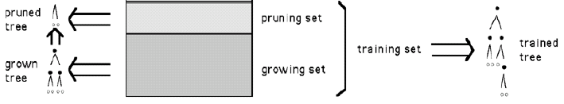
Reduced Error Pruning
This simplification method is based on the Reduced Error Pruning (REP) proposed by Quinlan(1987) for decision trees
  It uses a pruning set to evaluate the effectiveness of the subtrees of a model tree T
  The tree is evaluated according to the mean square error (MSE)
  The pruning set is independent of the set of observations used to build the tree T
Notes:
This method is based on the Reduced Error Pruning (REP) proposed by Quinlan for decision trees .
It uses a pruning set to evaluate the goodness of the subtrees of a model tree T.
The pruning set is independent of the set of observations used to build the tree T, therefore, the training set must be partitioned into a growing set used to build the tree and a pruning set used to simplify T.

Slide 23
Reduced Error Pruning
For each internal node t REP compare:
  MSE_{P}(T)
  MSE_{P} (π_{T}(t))
  and then returns the better tree between T and π_{T}(t)
π_{T}(t)
T
Y=a+bX₁
X’₃ ≤ α
X’₂ ≤ β
Y’=i+lX’₄
MSE_{P} (π_{T} (t)) ≤ MSE_{P}(T)
T→ π_{T}(t)
Y’=c+dX’₃
X’₄ ≤ γ
Y’=m+nX’₂
Y’=e+fX’₂
Y’=g+hX’₃
The REP is recursively repeated on the simplified tree. The nodes to be pruned are examined according to a bottom-up traversal strategy
Notes:
For each internal node t, it compares the mean square error (MSE) computed on the pruning set when the subtree T_{t} is kept,
with the MSE computed on the same set when T_{t} is pruned and the best regression function is associated to the leaf t.
In the case the MSE computed for the whole tree is greater than the mean square error computed for the tree obtained by applying the pruning operator we prune the original tree T by removing the sub-tree rooted in t and replacing t with a leaf node.
When the node t is turned into a leaf the model associated to t is entirely determined on the basis of the growing set.
The pruning is repeated on the simplified tree until further pruning increases the MSE. The nodes to be pruned are examined according to a bottom-up traversal strategy.

Slide 24

Reduced Error Grafting
Problem: if t is a node of T that should be pruned according to some criterion, while t' is a child of t that should not be pruned according the same criterion, such pruning strategy:
  either prunes and loses the accurate branch
  or does not prune at all and keeps the inaccurate branch T_{t}
T
Y=a+bX₁
X’₃ ≤ α
t
X’₂ ≤ β
Y’=i+lX’₄
Y’=c+dX’₃
t’
X’₄ ≤ γ
Y’=e+fX’₂
Y’=g+hX’₃
Possible solution: grafting operator that allows the replacement of a sub-tree by one of its branches
Notes:
Let’s consider a problem that is embedded in a pruning strategy.
Let T a model tree induced by SMOTI with a node t that should be pruned according to pruning criterion,
while t' is a child of t that should not be pruned according the same criterion,
such pruning strategy either prunes and loses the accurate branch or does not prune at all and keeps the inaccurate branch T_{t}. On the contrary, REG acts by grafting onto the place of t, so saving the good sub-branch and deleting the useless node t.
A solution is the use of a grafting operator that allows the replacement of a subtree by one of its good sub-branch
and deletes the useless node t.

Slide 25
Reduced Error Grafting
The algorithm REG(T) operates recursively.
It analyzes the complete tree T. For each split
node t return the better tree between T and γ_{T}(t,t’) according to the mean square error computed on an independent pruning set
T
Y=a+bX₁
X’₃ ≤ α
t
t’
X’₄ ≤ γ
X’₂ ≤ β
Y’=i+lX’₄
MSE_{P} (γ _{T} (t,t’)) ≤ MSE_{P}(T)
T→ γ_{T}(t,t’)
Y’=e+fX’₂
Y’=g+hX’₃
t’
Y’=c+dX’₃
X’₄ ≤ γ
Y’=e+fX’₂
Y’=g+hX’₃
Notes:
The Reduced Error Grafting (REG) is conceptually similar to REP.
It uses an independent pruning set to evaluate the goodness of T', a subtree of T.
The algorithm recursively analyzes the complete tree T and, for each split node t,
it compares the MSE made on the pruning set when the subtree T_{t} is kept,
with the MSE made on the pruning set when T_{t} is turned into T_{t’} where t’ is a child of t and t is a splitting node.
The nodes are examined according to a bottom-up traversal strategy.

Slide 26
Empirical evaluation
For pairwise comparison with Retis and M5’, which art the state-of-the-art model tree induction systems the non-parametric Wilcoxon two-sample paired signed rank test is used.
Experiments (Malerba et al, 2004¹):
  laboratory-sized data sets
  UCI datasets
¹D. Malerba, F. Esposito, M. Ceci & A. Appice (2003). Top-Down Induction of Model Trees with Regression and Splitting Nodes. IEEE Transactions on Pattern Analysis and Machine Intelligence, PAMI, 26(5), 612-625, 2004 .

Slide 27
Empirical Evaluation on Laboratory-sized Data
Model trees are automatically built for learning problems with nine independent variables (five continuous and four discrete) where discrete variables take values in the set {A, B, C, D, E, F, G}.
The depth of the model-trees varies from four to nine.
Fifteen model trees are generated for each depth value, for a total of 90 trees.
Sixty data points are randomly generated for each leaf so that the size of the data set associated with a model tree depends on the number of leaves in the tree itself.

Slide 28
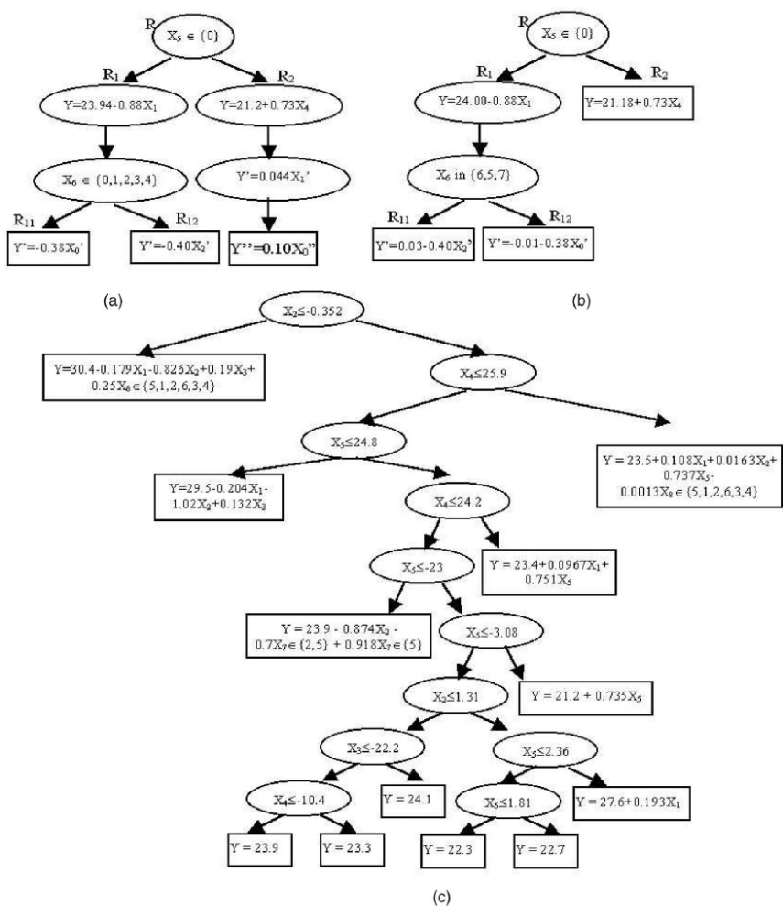
Empirical Evaluation on Laboratory-sized Data
A theoretical model tree of depth 4 used in the experiments,
the model tree induced by SMOTI from one of the cross-validated training sets, and
the corresponding model tree built by M5’ for the same data.

Slide 29
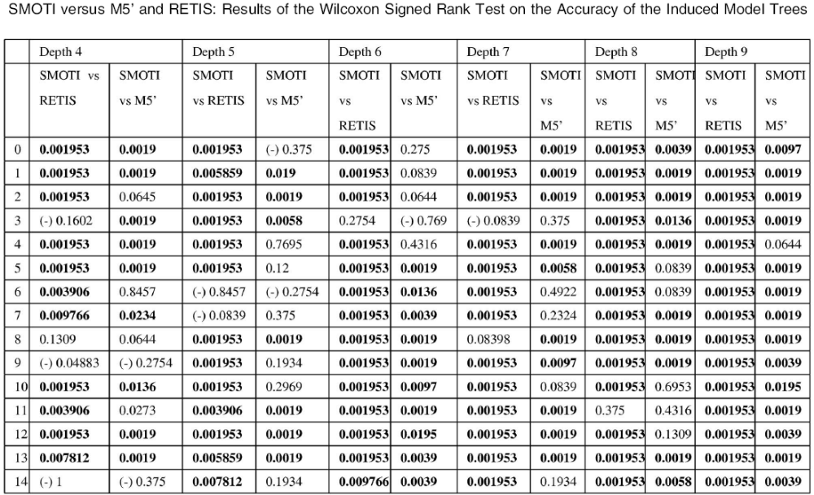
Empirical Evaluation on Laboratory-sized Data

Slide 30
Empirical Evaluation on Laboratory-sized Data
Conclusions:
SMOTI performs generally better than M5’ and RETIS on data generated from model trees where both local and global effects can be represented.
By increasing the depth of the tree, SMOTI tends to be more accurate than M5’ and RETIS.
When SMOTI performs worse than M5’ and RETIS, this is due to relatively few hold-out blocks in the cross validation so that the difference is never statistically significant in favor of M5’ or RETIS.

Slide 31
Empirical Evaluation on UCI data
SMOTI was also tested on fourteen data sets taken from either the:
  UCI Machine Learning Repository
  The site of WEKA (www.cs.waikato.ac.nz/ml/weka/)
  The site of HTL (www.niaad.liacc.up.pt/~ltorgo/Regression/DataSets.html)

Slide 32
… Empirical Evaluation on UCI data…
Dataset | Avg.MSE |  |  | SMOTI vs.Retis | SMOTI vs. M5’
 | SMOTI | Retis | M5’
Abalone | 2.53 | 6.03 | 2.77 | (+)0.0019 | (+)0.19
AutoMpg | 3.14 | NA | 3.20 | NA | (+)0.55
AutoPrice | 2246.03 | NA | 2358.81 | NA | (+)0.69
Bank8FM | 0.03 | 0.46 | 0.04 | (+)0.0019 | (+)0.064
Cleveland | 1.31 | 2.97 | 1.24 | (+)0.0097 | (-)0.23
DeltaAilerons | 0.0002 | 0.001 | 0.0002 | (+)0.0273 | (-)0.64
DeltaElevators | 0.004 | 0.005 | 0.0016 | (+)0.13 | (-)0.19
Housing | 3.58 | 36.36 | 4.27 | (+)0.0019 | (+)0.04
Kinematics | 0.15 | 1.98 | 0.19 | (+)0.0019 | (+)0.0039
MachineCPU | 55.31 | 305.60 | 57.35 | (+)0.0039 | (+)0.55
Pyrimidines | 0.10 | 0.07 | 0.09 | (-)0.4316 | (-)0.84
Stock | 1.82 | 1.59 | 1.10 | (-)0.4375 | (-)0.03
Triazines | 0.20 | NA | 0.15 | NA | (-)0.02
WisconsinCancer | 51.41 | NA | 45.40 | NA | (-)0.625

Slide 33
… Empirical Evaluation on UCI data.
For some datasets SMOTI discovers interesting patterns that no previous study on model trees has ever revealed.
This aspect proves the easy interpretability of the model trees induced by SMOTI.
For example:
Abalone (marine crustaceans).
The goal is to predict the age (number of rings). SMOTI builds a model tree with a regression node in the root. The straight-line regression selected at the root is almost invariant for all model trees and expresses a linear dependence between the number of rings (dependent variable) and the shucked weight (independent variable). This is a clear example of global effect, which cannot be grasped by examining the nearly 350 leaves of the unpruned model tree induced by M5’ on the same data.

Slide 34
… Empirical Evaluation on UCI data.
Auto-Mpg (city-fuel consumption in miles per gallon).
For all 10 cross-validated training sets, SMOTI builds a model tree with a discrete split test in the root. The split partitions the training cases in two subgroups, one whose model year is between 1970 and 1977 and the other whose model year is between 1978 and 1982.
1973: OPEC oil embargo.
1975: the US Government set new standards on fuel consumption for all Vehicles. These values, known as C.A.F.E. (Company Average Fuel Economy) standards, required that, by 1985, automakers doubled average new car fleet fuel efficiency.
1978: C.A.F.E. standards came into force.
SMOTI captures this temporal watershed.

Slide 35
References
D. Malerba, F. Esposito, M. Ceci & A. Appice.
Top-Down Induction of Model Trees with Regression and Splitting Nodes.
IEEE Transactions on Pattern Analysis and Machine Intelligence, PAMI, 2004, 26(5), 612-625.
M.Ceci, A.Appice & D. Malerba.
Comparing Simplification Methods for Model Trees with Regression and Splitting Nodes.
In Z. Ras & N. Zhong (Eds), International Symposium On Methodologies For Intelligent Systems, ISMIS 2003. Series: Lecture Notes in Artificial Intelligence, 2871 49-56, Maebashi City, Japan, October 28-31, 2003.
SMOTI has been implemented and is available as a component of the system KDB2000.
http://www.di.uniba.it/~malerba/software/kdb2000/index.htm

